Slide 1
Smart India Hackathon
RK-55
Criminal Navigation using Mobile/Email based Tracking System
Presented by:
Team Aegis
-Aashutosh Kumar Mishra
-Priyanka Jha
-Tushar Pradhan
-Sweety Dutta
-Kumari Neha
-Ruma Kumari

Slide 2
Prime objective::
To bring effectiveness in terms of speed of execution for the personals.
Use of high end technologies to decrease the efforts of field officers and introducing them to ease of technology
Let us hope to have a country which can be a safer place for those who work here, live here, stay here or even visit here.

Slide 3
Major Bifurcation
IDEA
Machine Learning – helping hands
Culmination of IOT and ML for tracking and navigating
Online Crime Reporting System

Slide 4
Machine Learning:
- Pedestrians and vehicle detection
- License plate(vehicle number) detection
- Face detection
-Pose Estimation

Slide 5
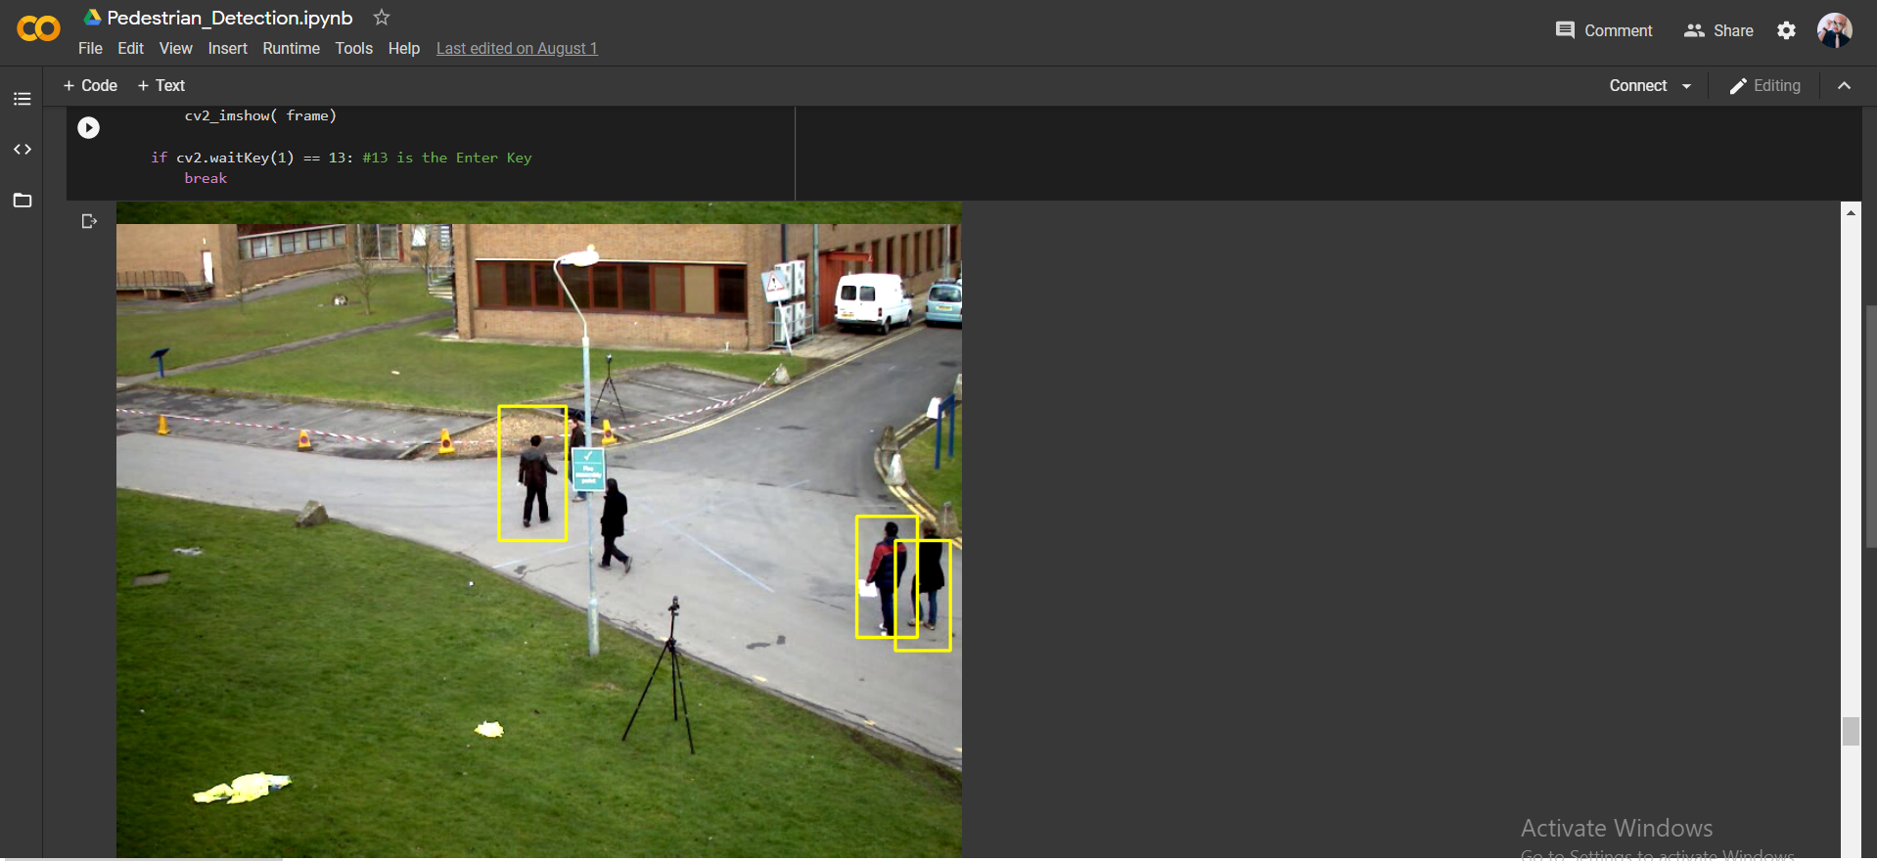
Output – Pedestrian detection

Slide 6
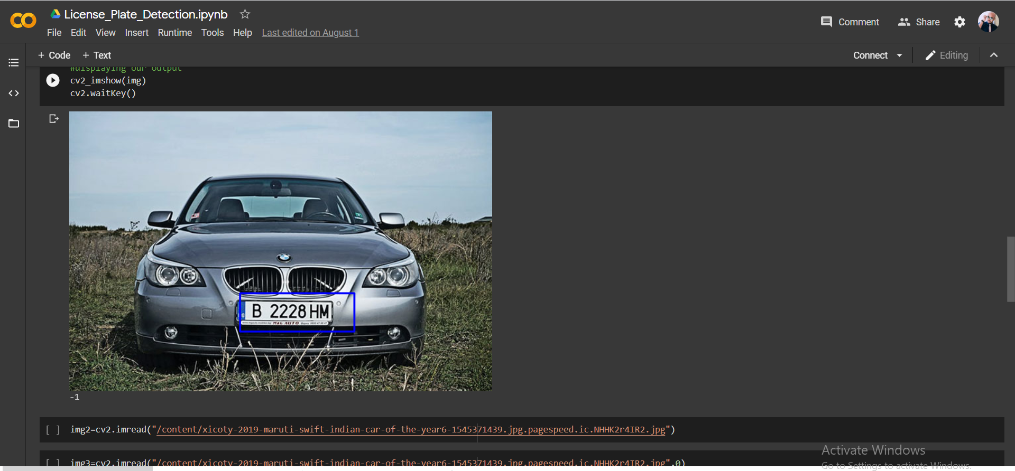
Output license plate detection

Slide 7
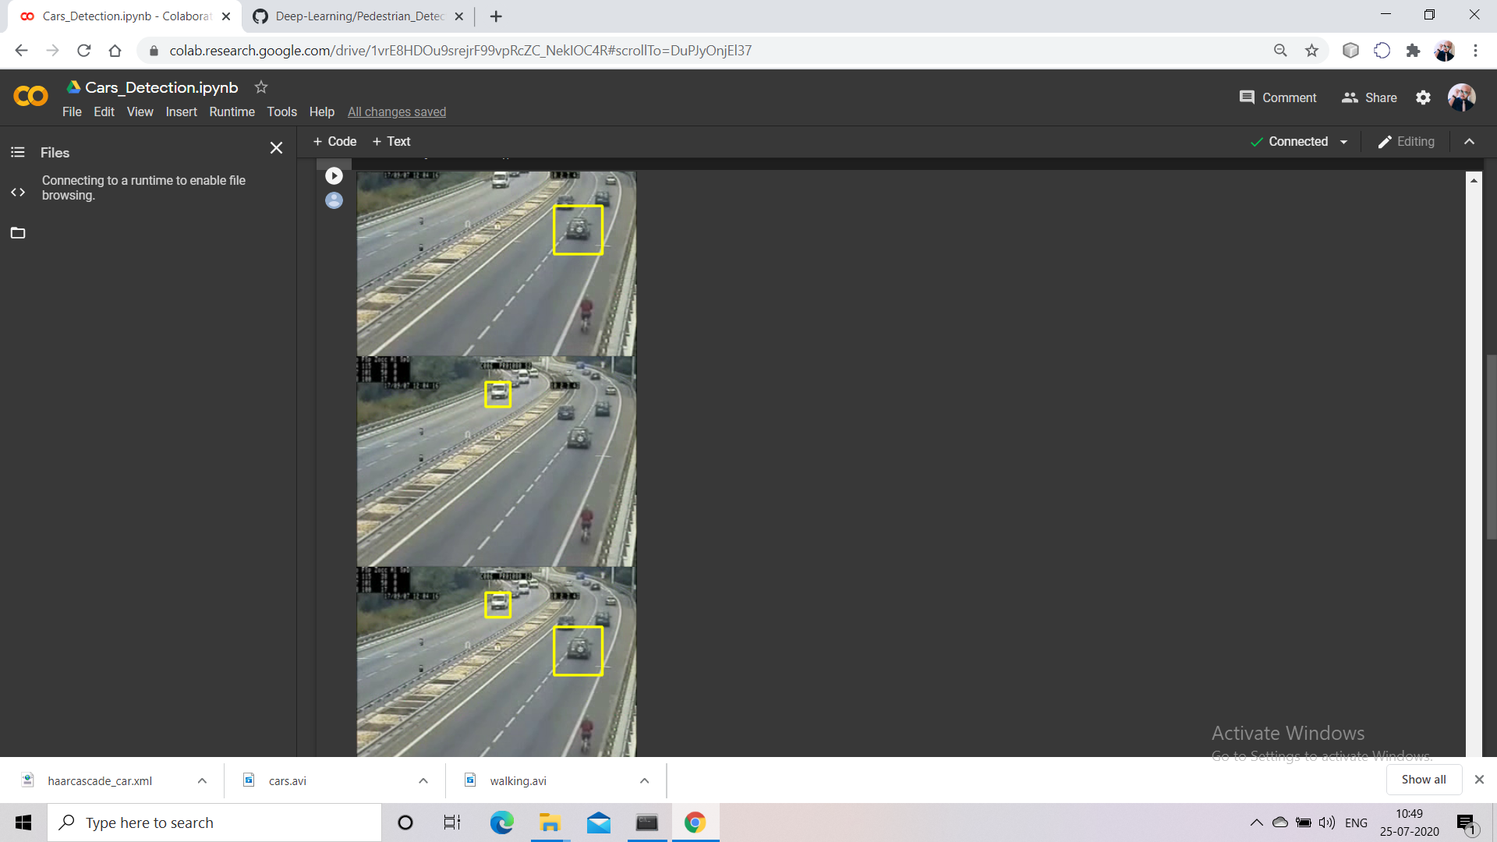
Output – vehicle detection

Slide 8
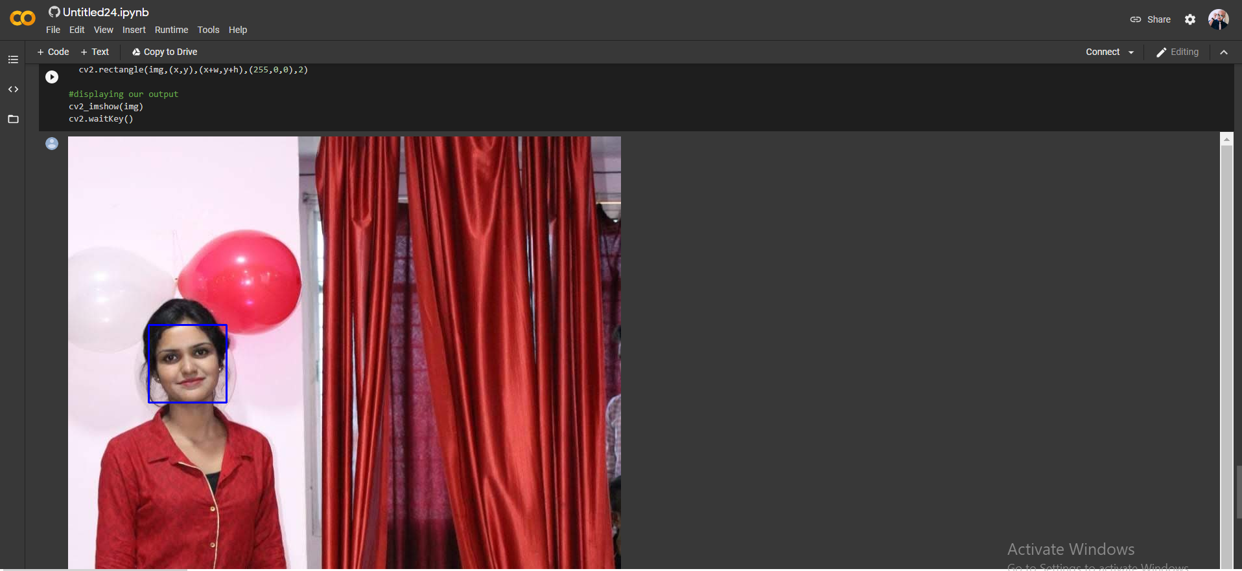
Output – Face Detection

Slide 9
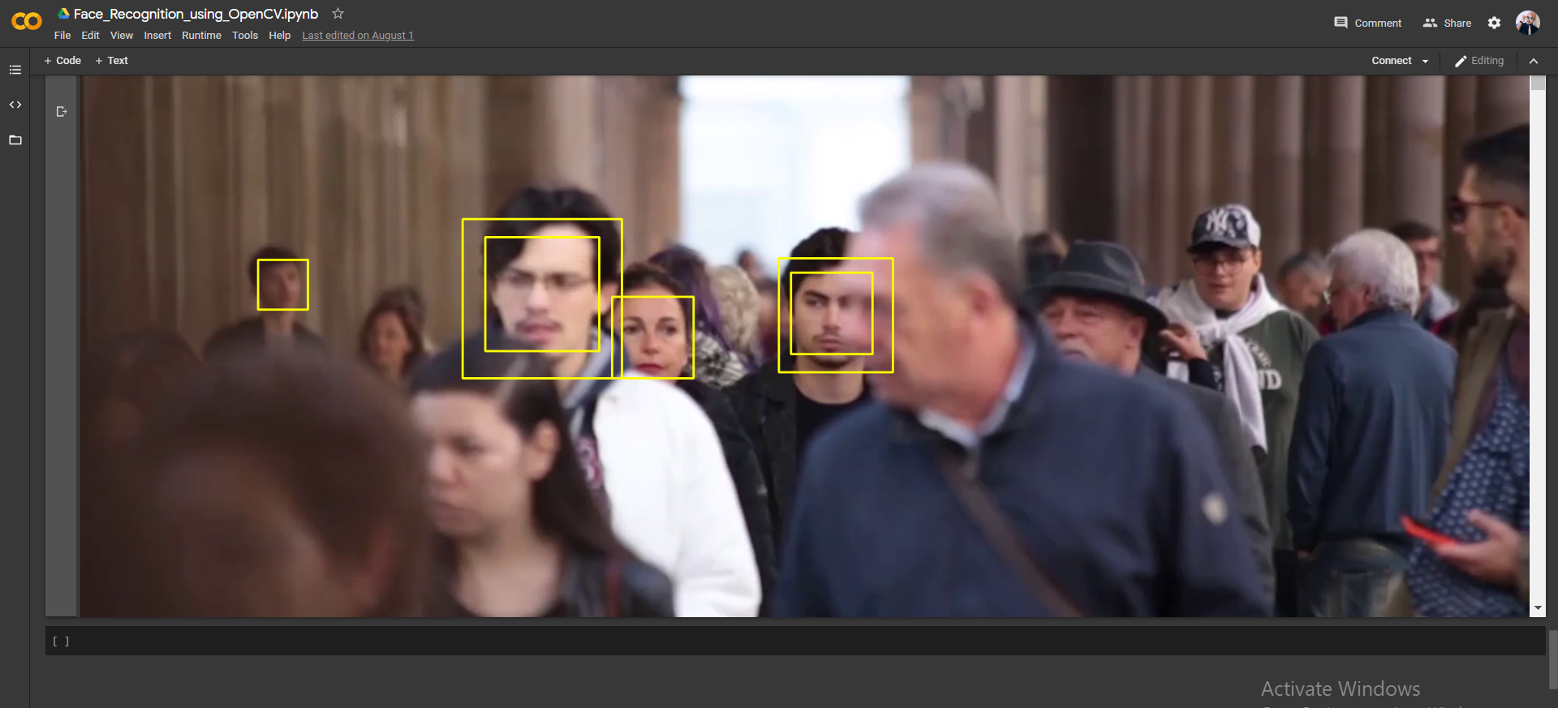
Face detection – with multiple images

Slide 10
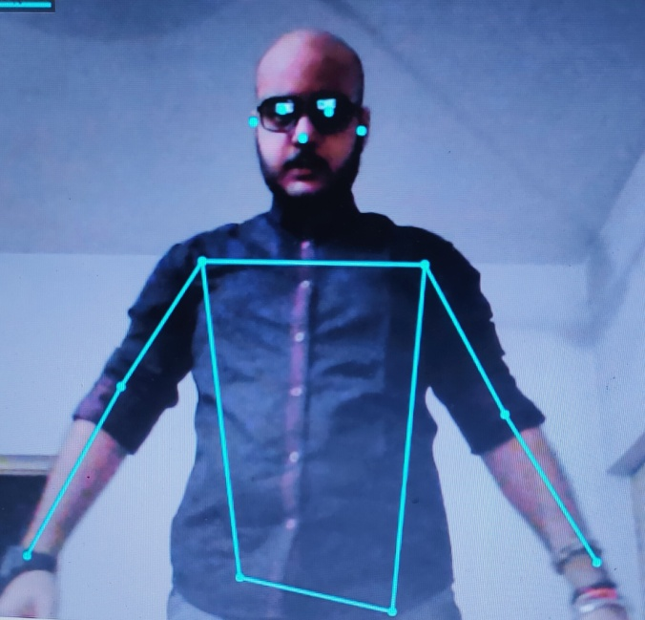
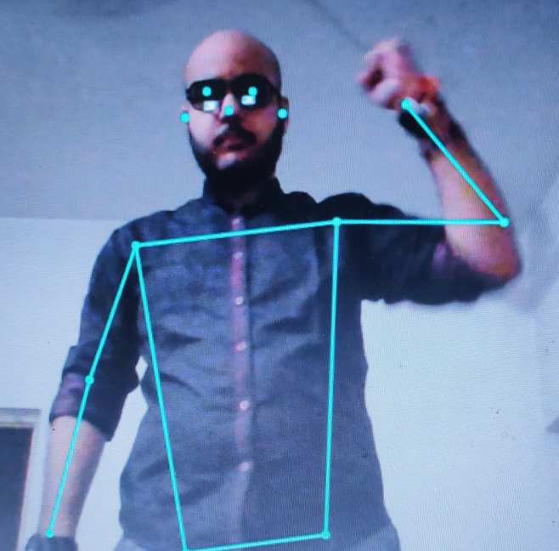
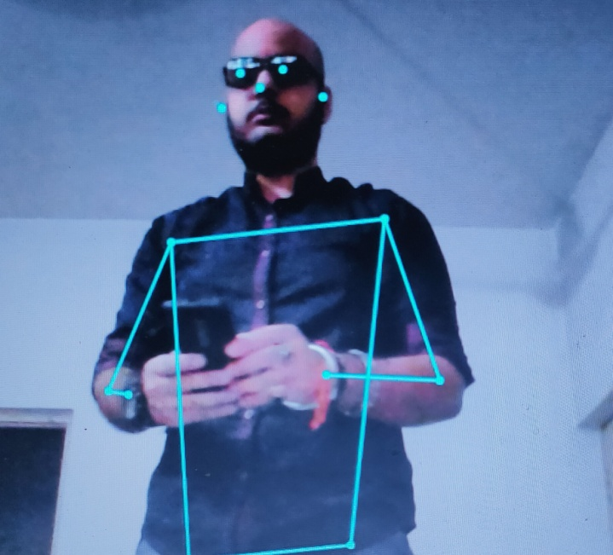
Pose Estimation

Slide 11
What major problems are we trying to focus:
Detection of crime like violation of traffic rules such as – speed limit violation, crossing road at inappropriate time and thus creating chaos and many more
Helping the assistants who are engaged with the job of creating boundaries across dead bodies and place of accident .
Face detection and finding the previous track record of an individual using previous databases.
Thermal imaging
Creating a web portal to register most commonly occurring crimes in India.

Slide 12
Online Crime Reporting System
Online crime reporting system which allows the user to file complaints or missing reports and keep a track of it.
Paste the Crime Reporting Folder in xampp/htdocs/
Open a browser and go to URL “http://localhost/phpmyadmin/”
Then, click on the databases tab Create a database naming “crime_portal” and then click on the import tab Click on browse file and select “crime_portal.sql” file which is inside the “Crime-Reporting-System” folder
Click on go.
After Creating Database,
Open a browser and go to URL “http://localhost/Crime-Reporting-System /”

Slide 13

Our Web portal’s interface ;

Slide 14
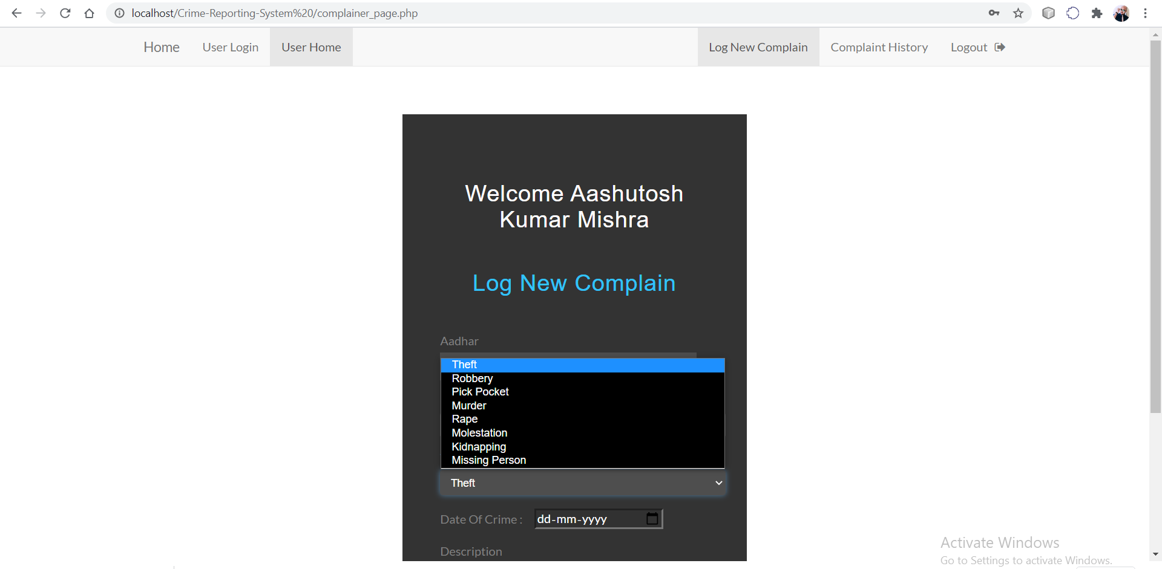
The available options for crime are;

Slide 15
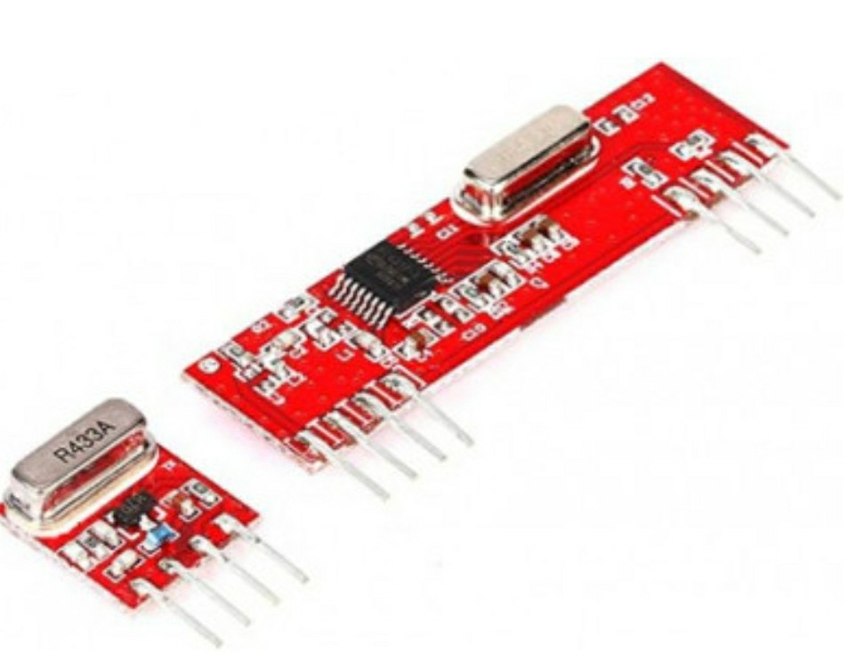
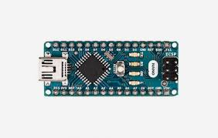
Components used:
433MHZ RF MODULE
Voltage: +5V
current: 9mA to 40mA. frequency: 433 MHz.
Distance: 3 meters to 100 meters
includes
ARDUINO NANO
The Arduino Nano is a small, complete, and breadboard-friendly board based on the ATmega328 (Arduino Nano 3.x). It has more or less the same functionality of the Arduino Duemilanove, but in a different package. It lacks only a DC power jack, and works with a Mini-B USB cable instead of a standard one.

Slide 16
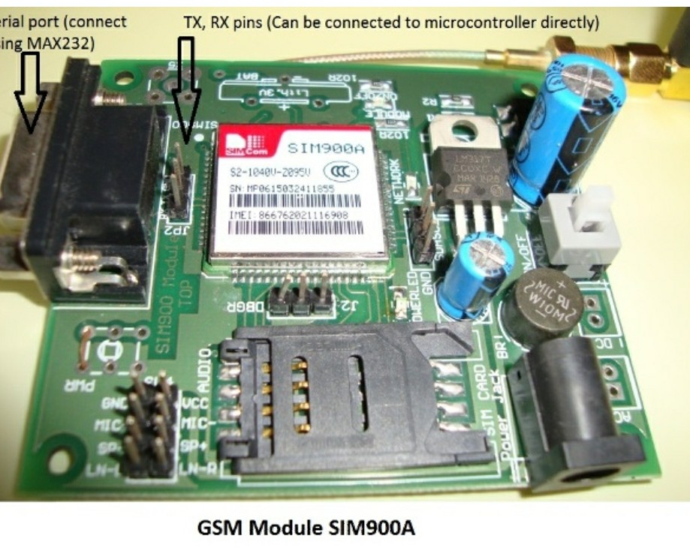
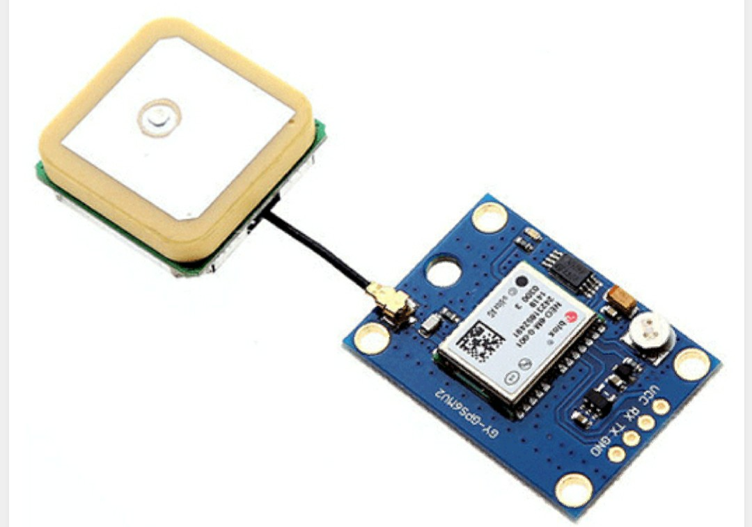
SIM900A GSM MODEM
GSM/GPRS Modem-RS232 is built with Dual-Band GSM/GPRS engine- SIM900A works on frequencies 900/ 1800 MHz.
NEO6M GPS MODULE
voltage: (2.7-3.6)V DC
Current: 67 mA
Baud rate: 4800-230400 bps
Communication Protocol: NEMA

Slide 17
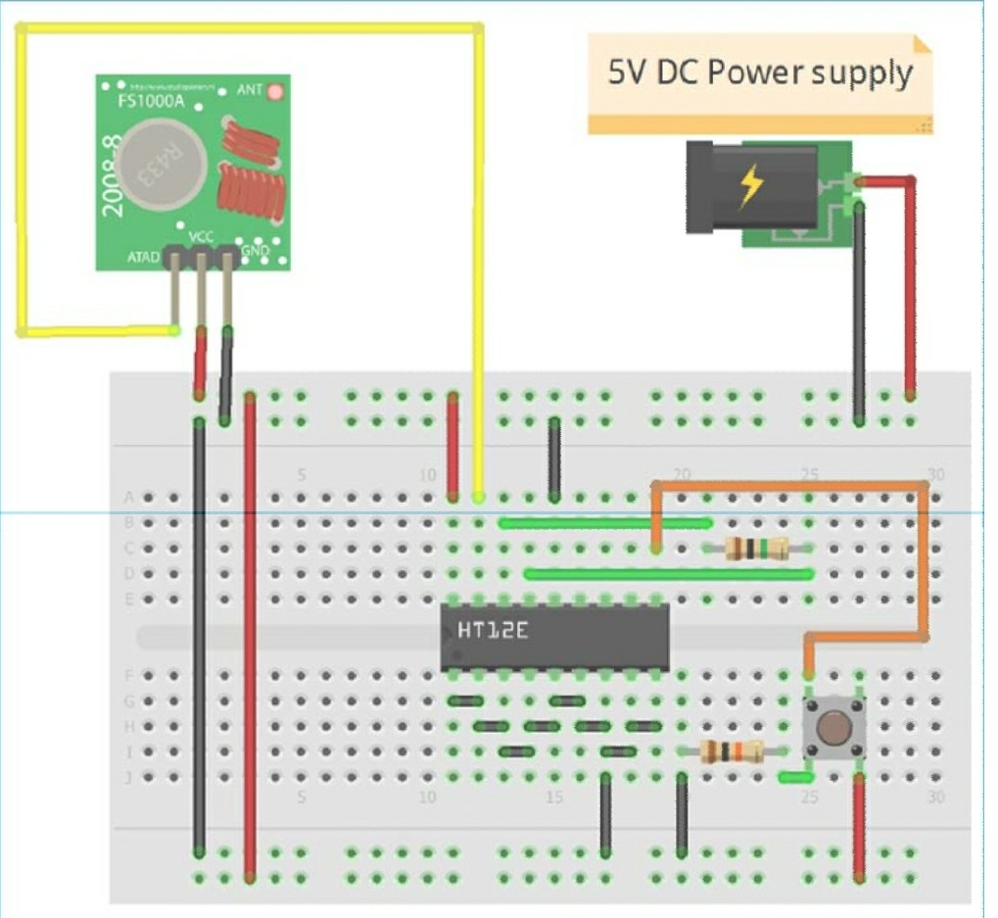
TRANSMITTER PART OF THE MODEL
RF TX
HT12D
Decoder

Slide 18
Transmitter Section:
In the RF Transmitter part, there will be an SOS button along with a 433 MHz RF transmitter, which will transmit the data to the receiver part wirelessly. The purpose of making two individual parts here is, to minimize the size of the transmitting module so that it can be worn as a wrist band. The circuit diagram for the transmitter part is shown in above slide.
Receiver Section:
In the RF Receiver section, the data transmitted from the wrist band (Transmitter part) is received by the device having a 433 MHz RF receiver. The RF receiver sends this information to Arduino through the digital pin. Arduino Nano then receives the signal and processes it using the program which is flashed into it. When the victim presses the SOS button in the transmitter part, a HIGH signal is generated and passes to the Arduino side, and then Arduino sends a signal to SIM900 modem, to send an SMS to Registered user along with the GPS coordinate which has already been stored in the Microcontroller by the help of NEO6M GPS module. The circuit diagram of the Receiver side is shown in next slide.

Slide 19
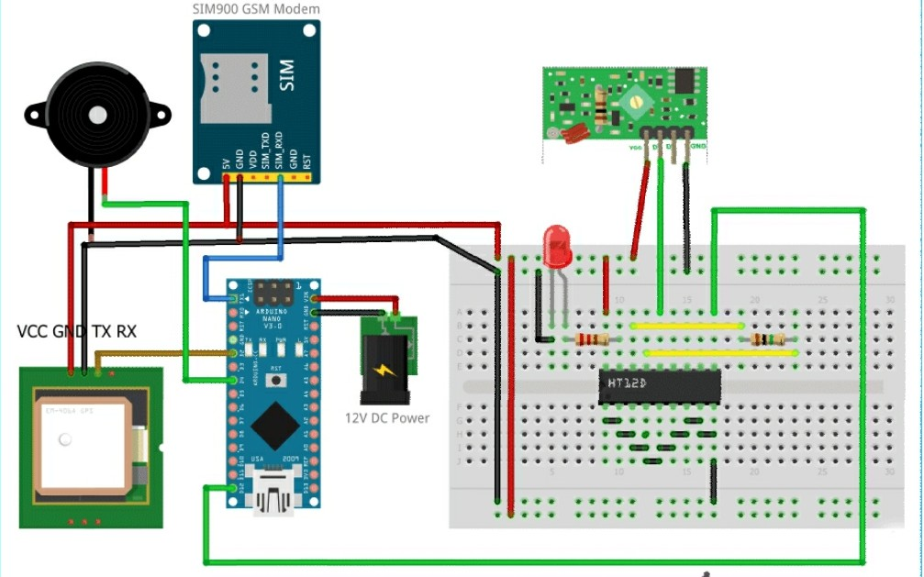
RECIVER PART OF THE MODEL TO BE INSTALLED IN THE STREET LIGHTS/ ELECTRIC POLES
ALARM
RF RX
SIM900A GSM
MODEM
HT12D
Decoder
ARDUINO NANO
GPS
ANTENNA

Slide 20
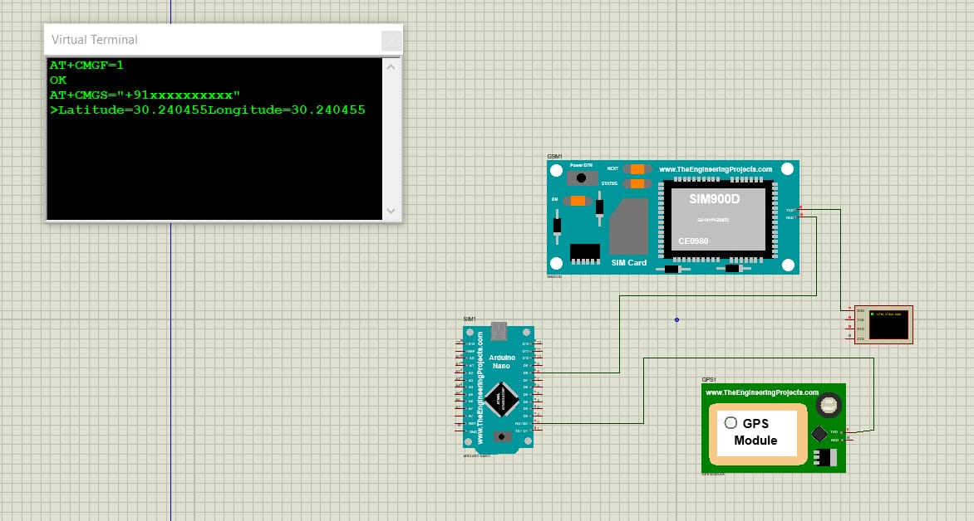
Outputs of Iot Section:

Slide 21
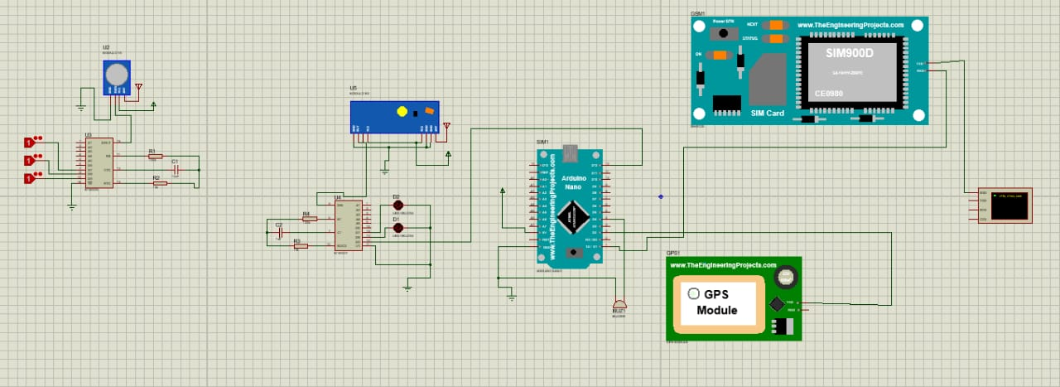
Complete Circuit connection

Slide 22
Culmination of IOT and ML for tracking and navigating
Victim will carry a hand band or ring which will consist of a transmitter and a button with herself and whenever there will be any misdeed he/ she can press the button.
Signal will get recieved by the receiver side (electric pole) and it will activate the alarm.
Though ARDUINO, GSM MODULE and GPS MODULE will get activated.
GSM module and GPS MODULE will send alert SMS along with current location to the nearest. Police station and ambulance

Slide 23
Requirements:
Windows 7 or higher
Python
PHP
MySQL database
i3 Processor Based Computer or higher
Memory: 1 GB RAM
Hard Drive: 50 GB
Monitor
Internet Connection
IOT devices : GPS module, GSM module, Arduino UNO and RF MODULE and more

Slide 24

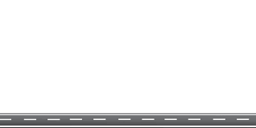


Setup present in this pole will get alert and send the required alert signals...
And when the car reaches the next pole where the setup is installed ,then the setup gets alert and msg signals are sent as required.

Slide 25
Thank You
Team Aegis

